Slide 1

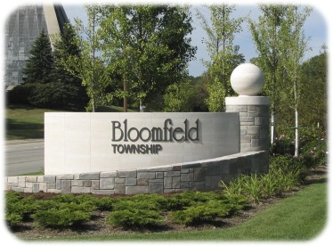
BLOOMFIELD TOWNSHIP
Township Supervisor Leo Savoie

Slide 2
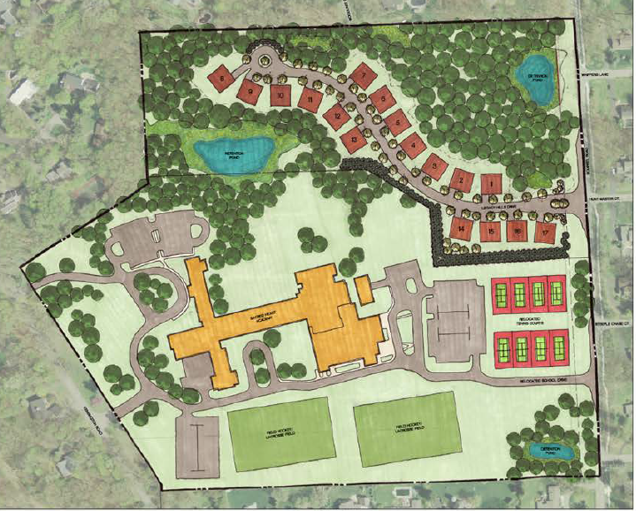
LEGACY HILLS RESIDENTIAL DEVELOPMENT
The cluster development includes 17 homes with a preserved woodland area to the west.
Legacy Hills and
Academy of the Sacred Heart site plan
Elevations

Slide 3
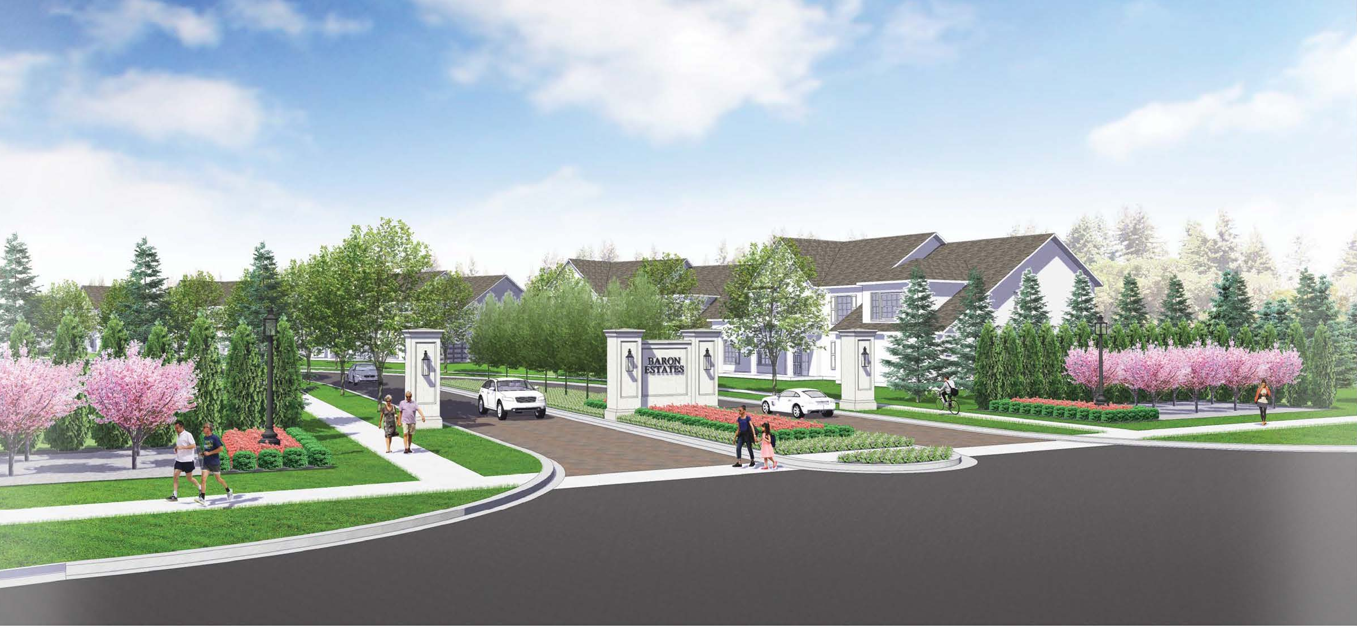
BARON ESTATES RESIDENTIAL PLANNED UNIT DEVELOPMENT
BY HUNTER PASTUER HOMES
The development plan includes 22 home sites with 2.1 acres of open space to include interior walkways, a gazebo and pond.
Proposed entrance off Long Lake Road

Slide 4
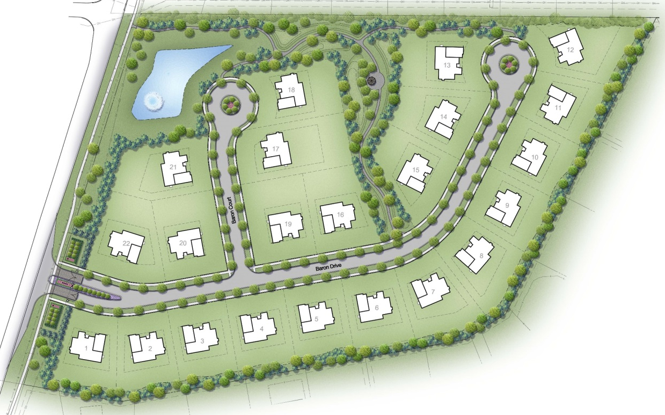
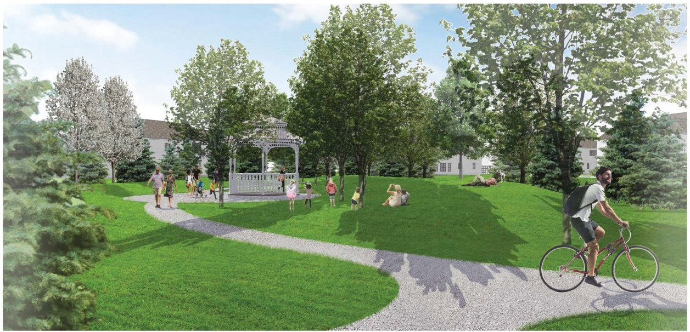
BARON ESTATES RESIDENTIAL PLANNED UNIT DEVELOPMENT
BY HUNTER PASTUER HOMES
Site plan with defined open space
Gazebo and walkways

Slide 5
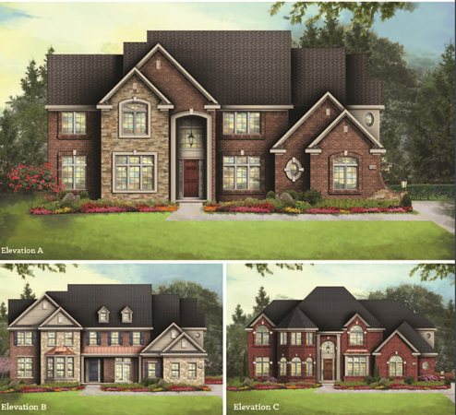
BARON ESTATES RESIDENTIAL PLANNED UNIT DEVELOPMENT
BY HUNTER PASTUER HOMES
Elevations

Slide 6
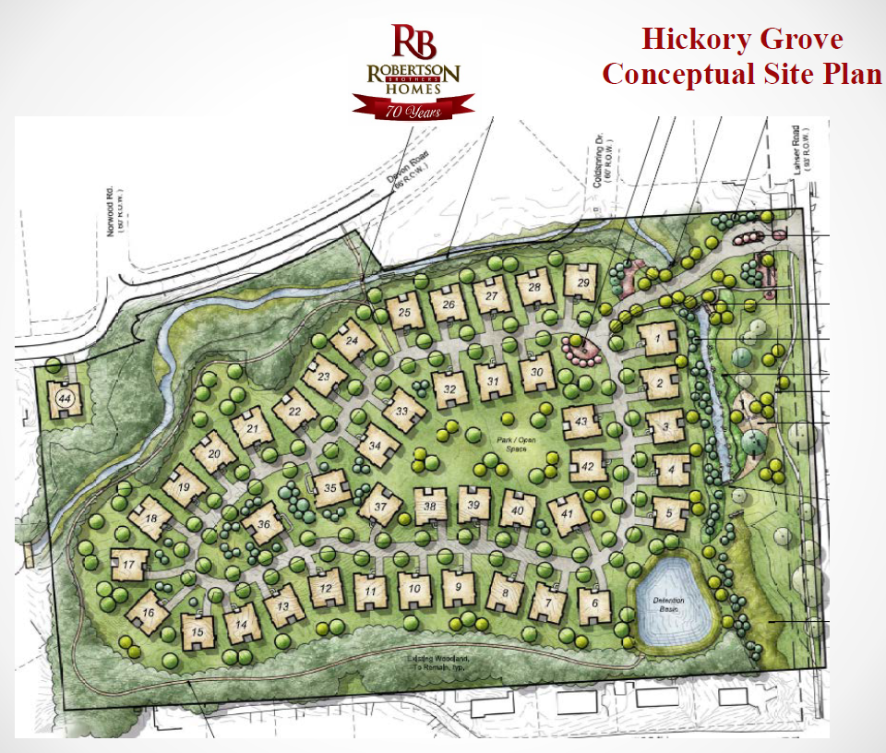
ROBERSTON BROTHERS DEVELOPMENT OF HICKORY GROVE SITE
The development plan includes 44 home sites with approximately 50% of open space provided.

Slide 7
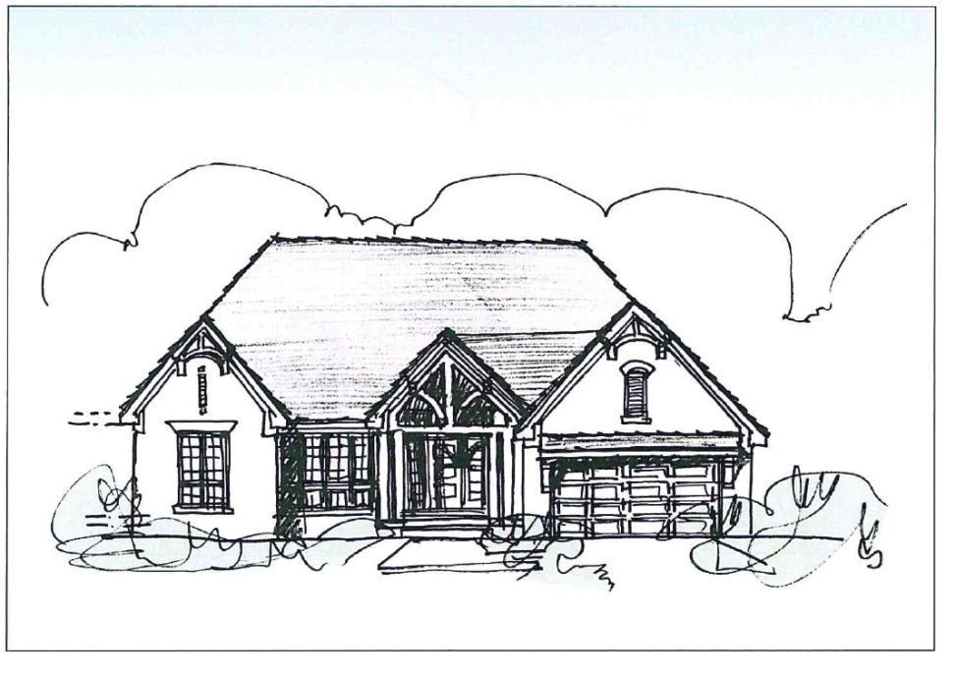
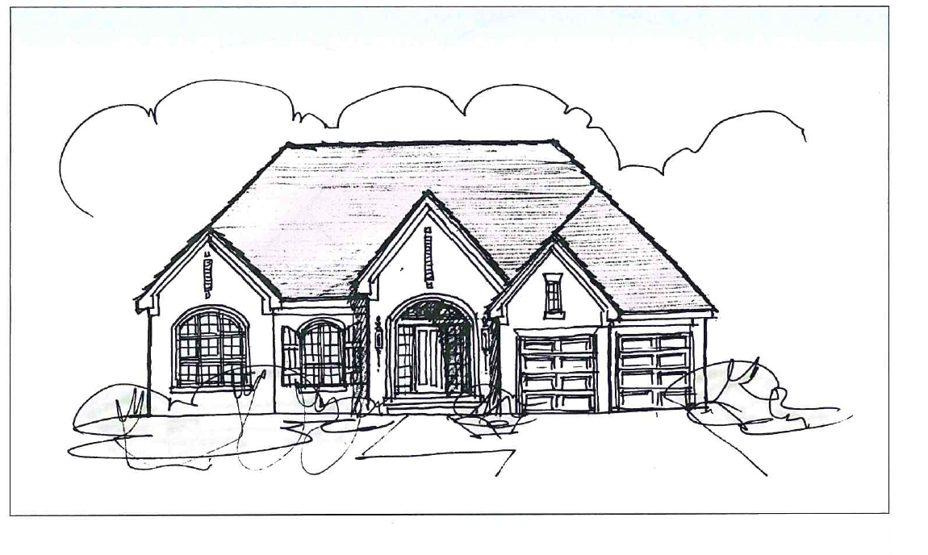
ROBERSTON BROTHERS DEVELOPMENT OF HICKORY GROVE SITE
Sample Elevations

Slide 8
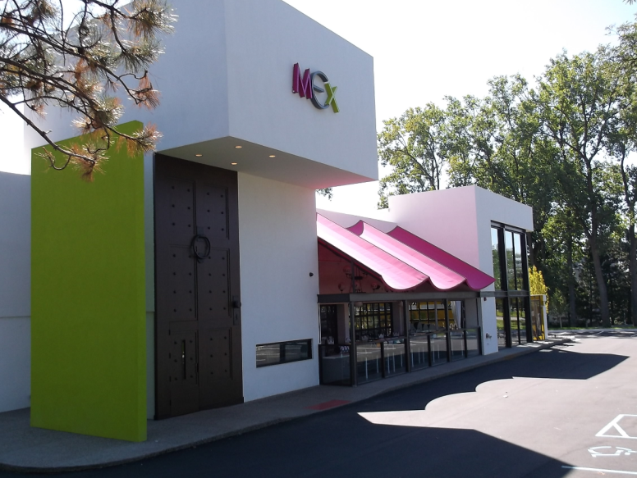
MEX RESTAURANT
Site plan

Slide 9
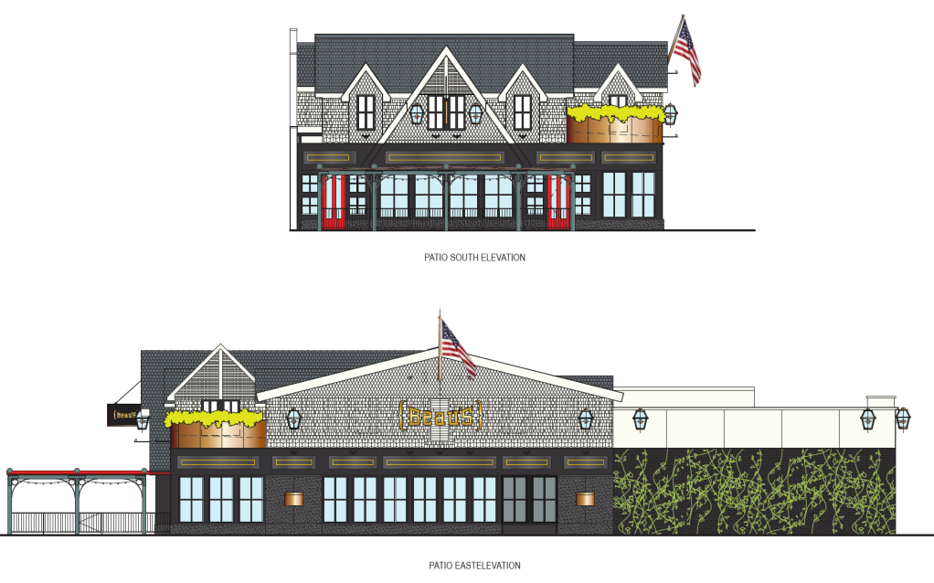
BEAU’S RESTURANT

Slide 10
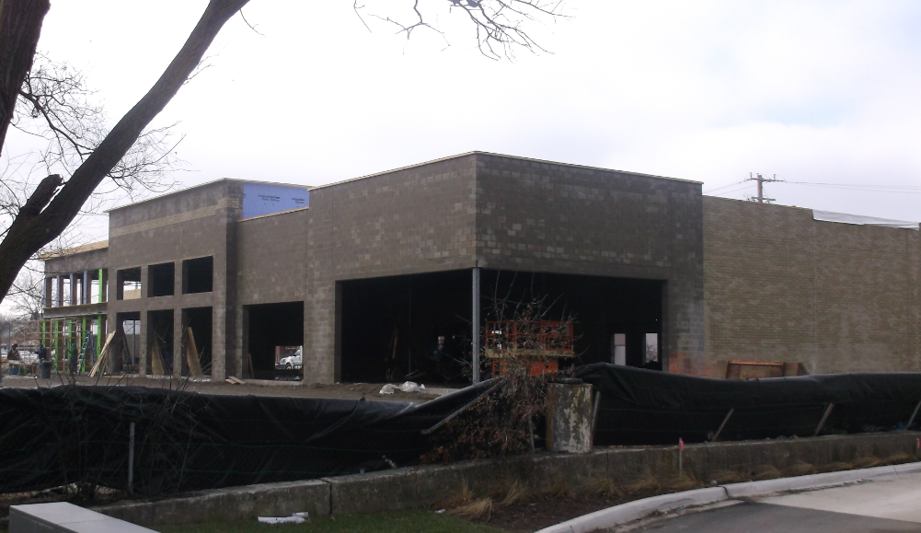
NEW OFFICE RETAIL BUILDING AT FORMER HOGAN’S SITE

Slide 11
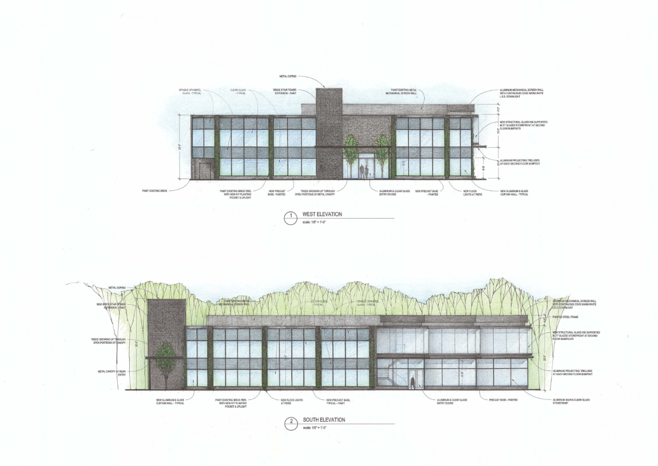
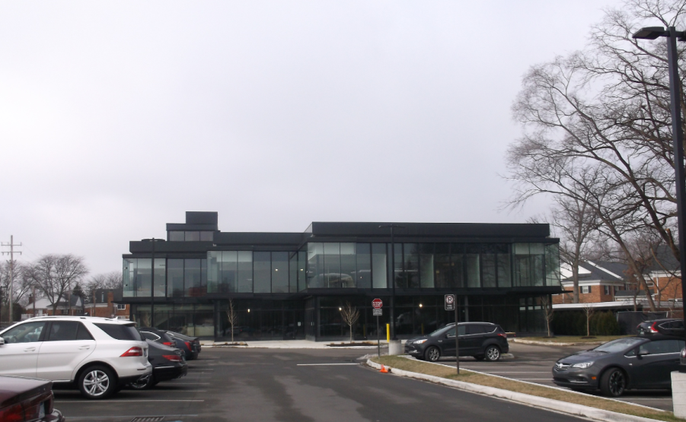
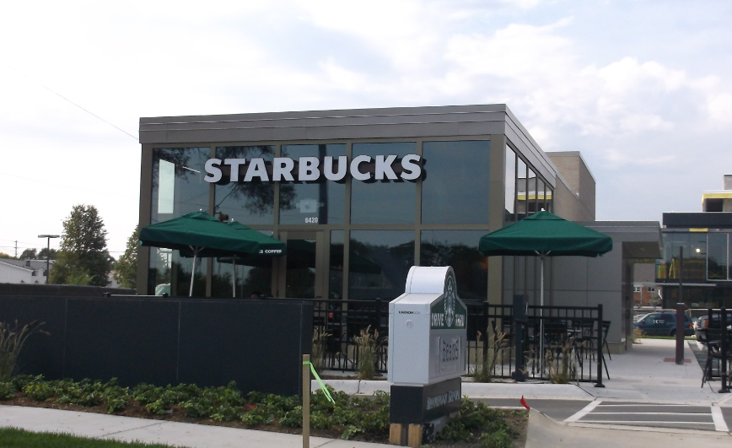
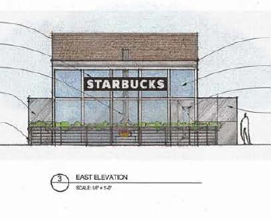
MAPLE/TELEGRAPH OFFICE BUILDING & STARBUCKS

Slide 12
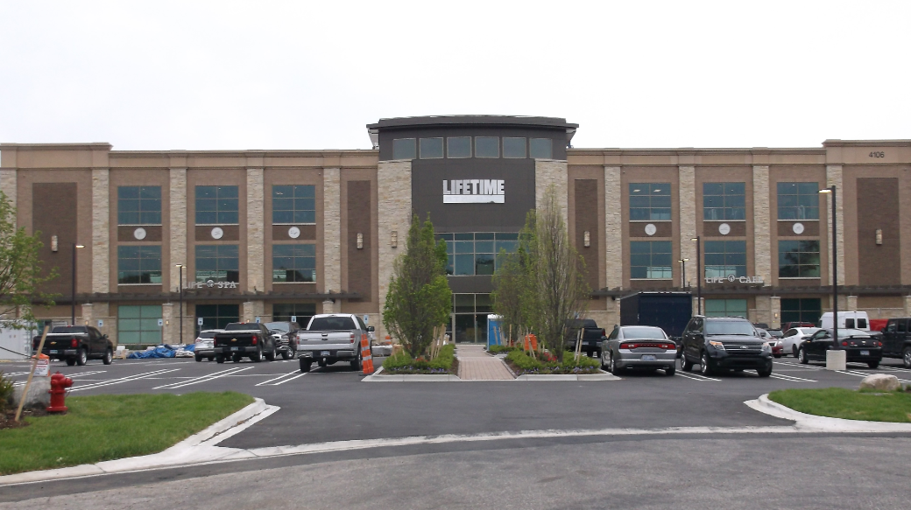
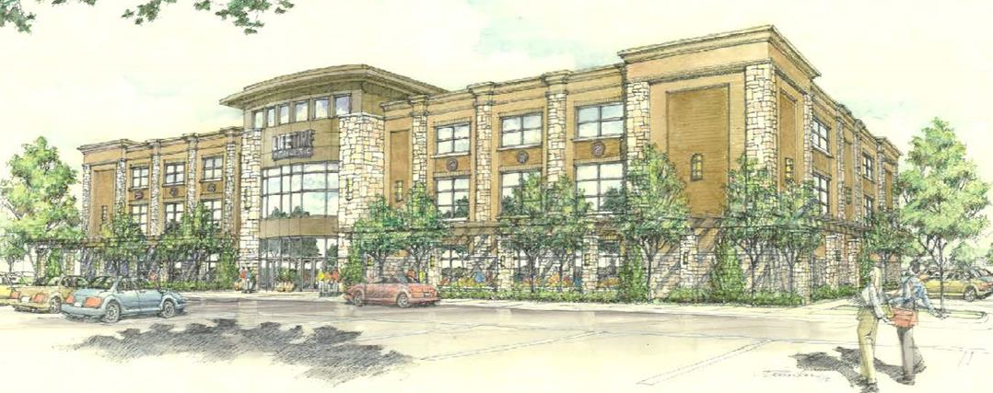
LIFETIME FITNESS

Slide 13
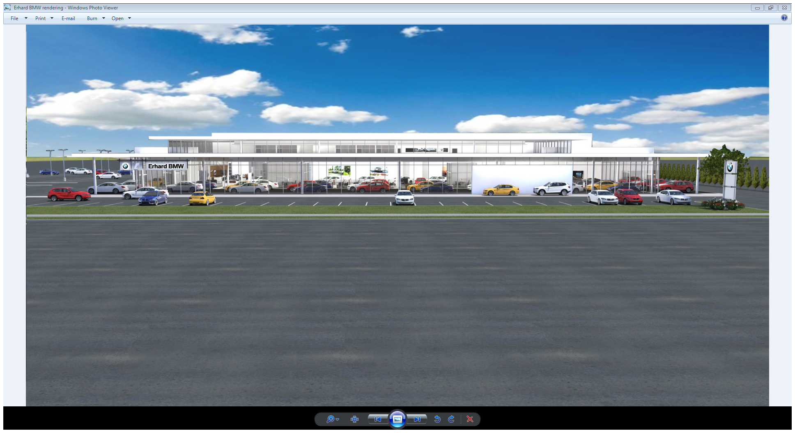
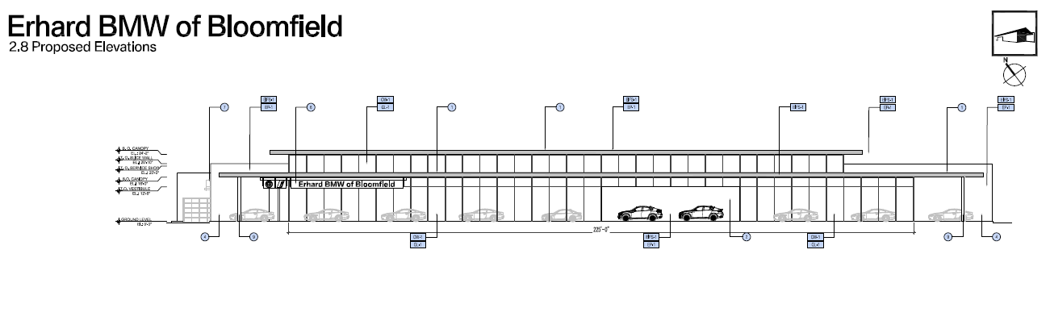
ERHARD BMW DEALERSHIP
Erhard BMW will be located in a new 87,000 square foot car dealership under construction at 1845 Telegraph Road

Slide 14
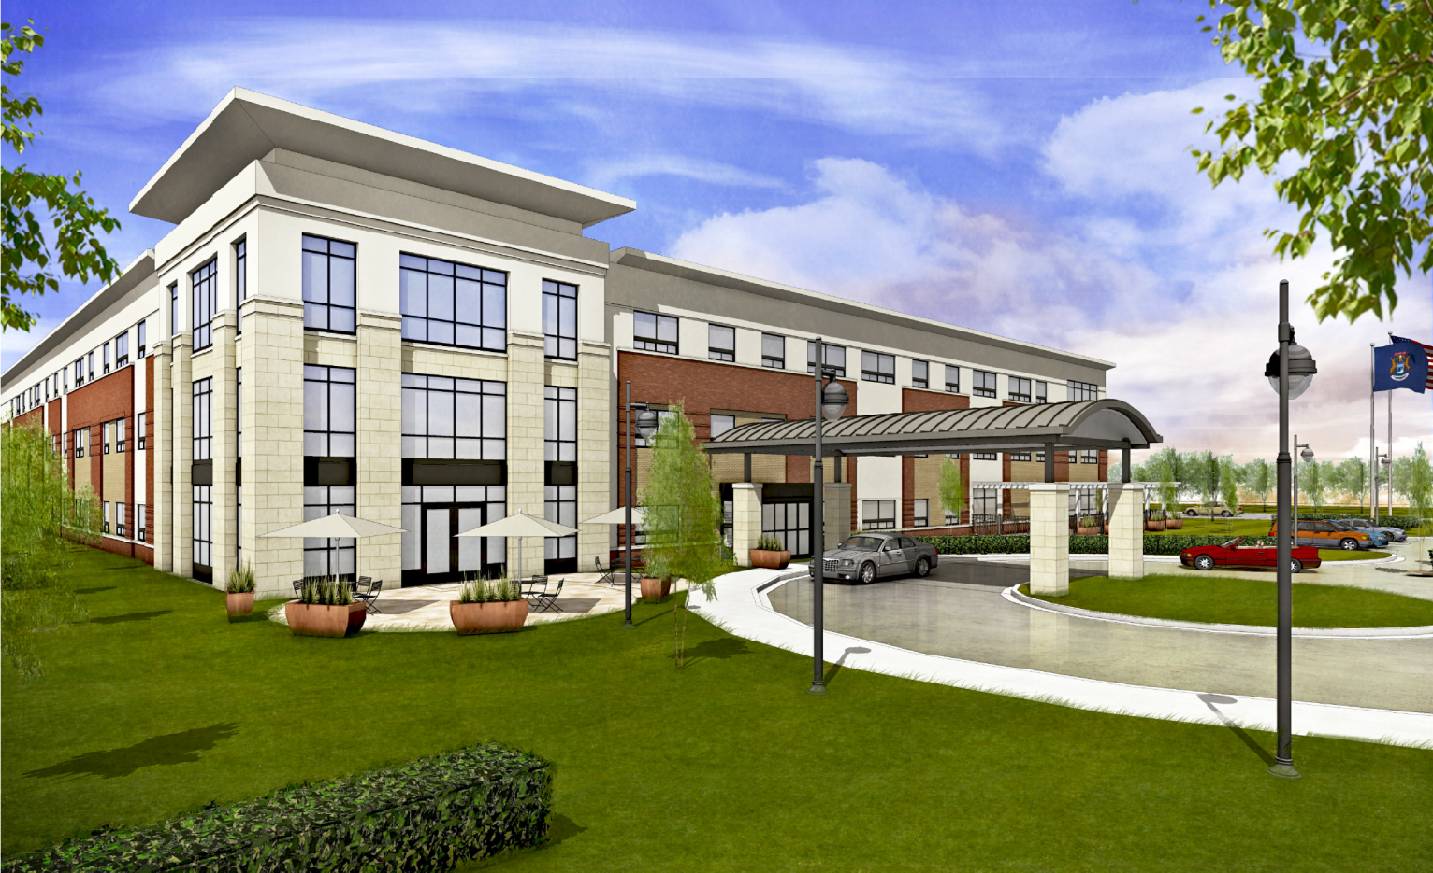
FIRST AND MAIN SENIOR LIVING
First and Main is a new senior living facility under construction at 50-100 W. Square Lake Rd. Once complete, the 100,900 square foot building will provide 102 residential units, as well as a lobby, dining rooms, kitchen, lounge, and other residential services.

Slide 15
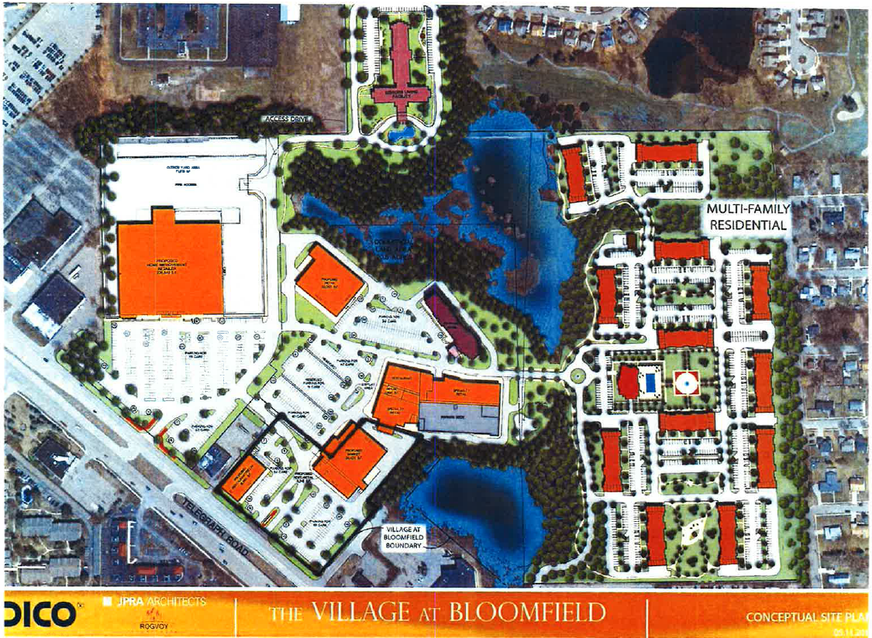
VILLAGE AT BLOOMFIELD

Slide 16
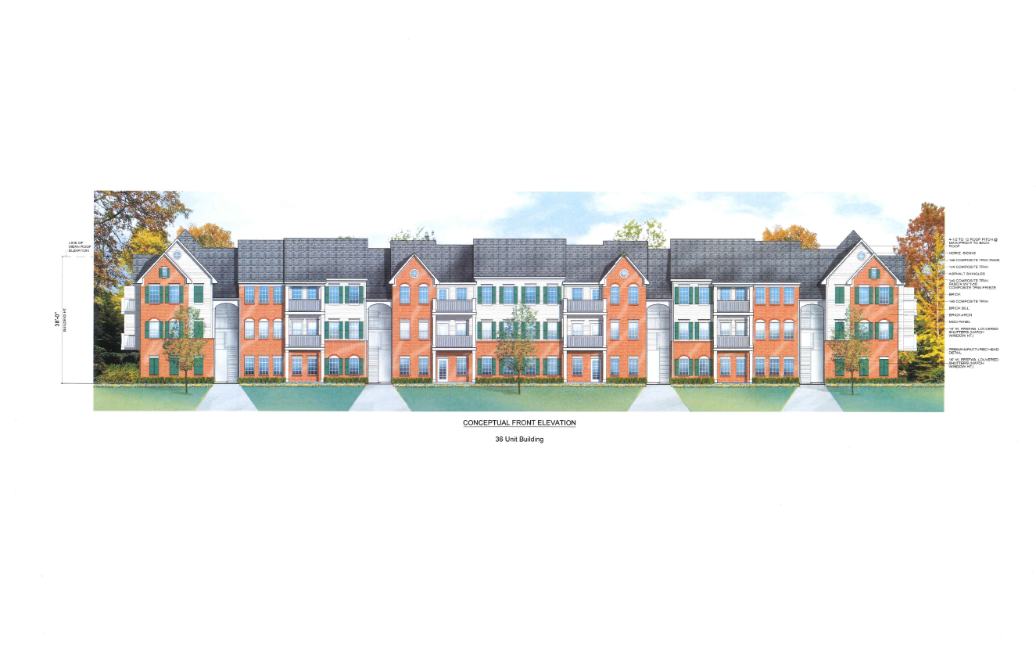
ELEVATIONS FOR MULTIPLE FAMILY RESIDENTIAL
VILLAGE AT BLOOMFIELD

Slide 17
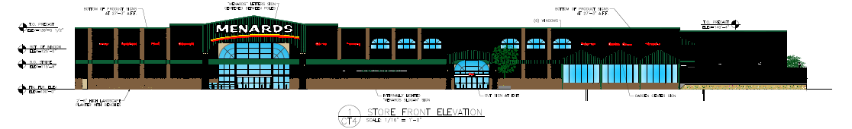
VILLAGE AT BLOOMFIELD
MENARDS ELEVATIONS

