Slide 1
Franklin: The Town that Time Forgot

Slide 2
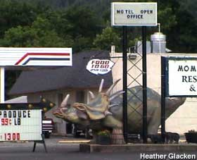
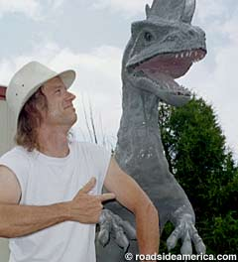
The Town That Time Forgot
Glasgow, Virginia
Visitors who pass through the small town of Glasgow will probably be surprised to see signs proclaiming it "The Town That Time Forgot" and to see businesses share its main thoroughfare with at least a dozen full-size fiberglass dinosaurs. Is Glasgow positioning itself as an American Brigadoon? Are there rich fossil beds beneath the Grocery Express and the Royal Order of Moose lodge?
Actually, unlike in other small towns grasping for fame, the attractions in Glasgow -- the dinosaurs -- were not created to justify its claim. The claim was created to justify the dinosaurs. All of it came from the mind of one man, Mark Cline, Glasgow resident and fiberglass artiste who, frankly, just likes making dinosaurs, and who wants to help his town in the best way that he knows how.

Slide 3
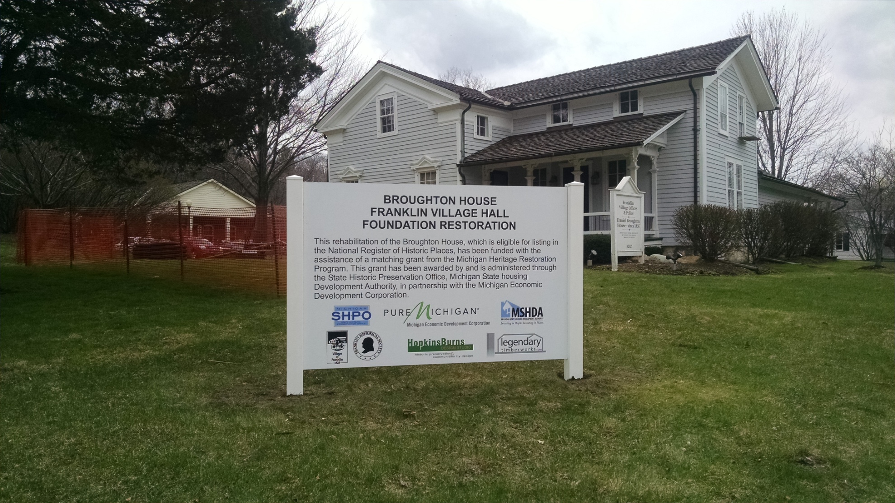

Slide 4
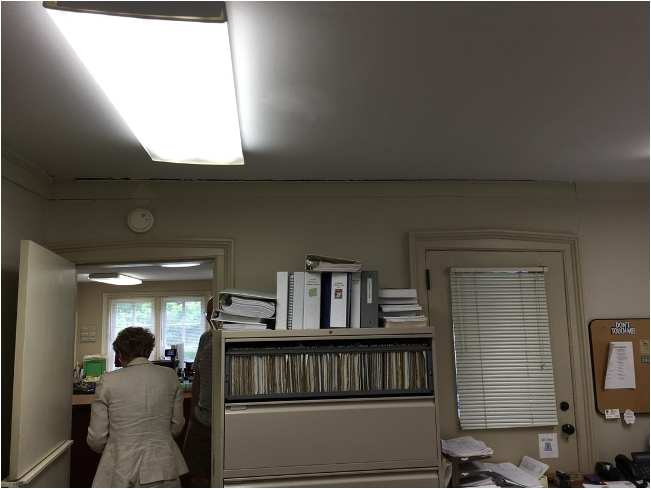

Slide 5
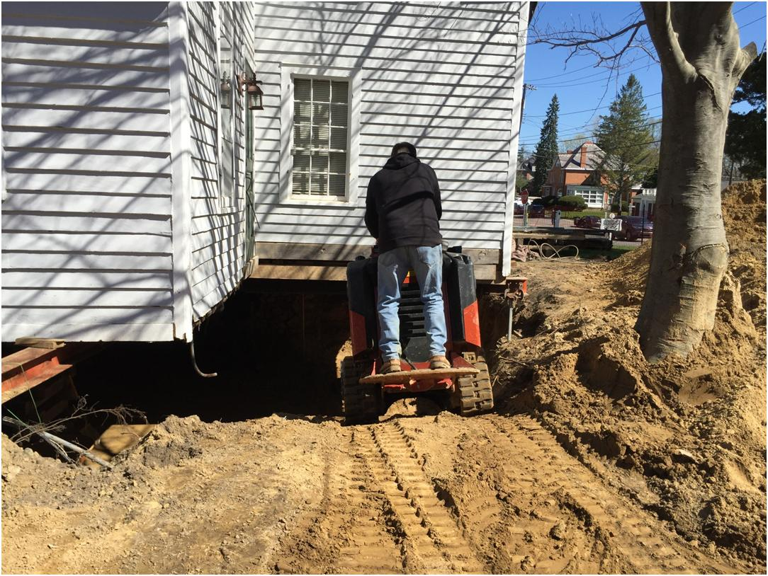

Slide 6
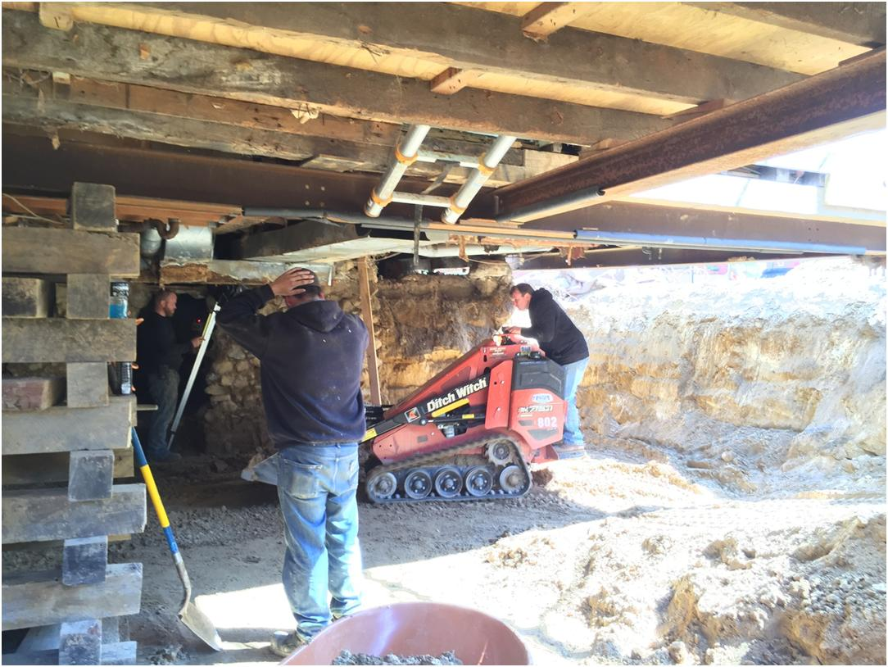

Slide 7
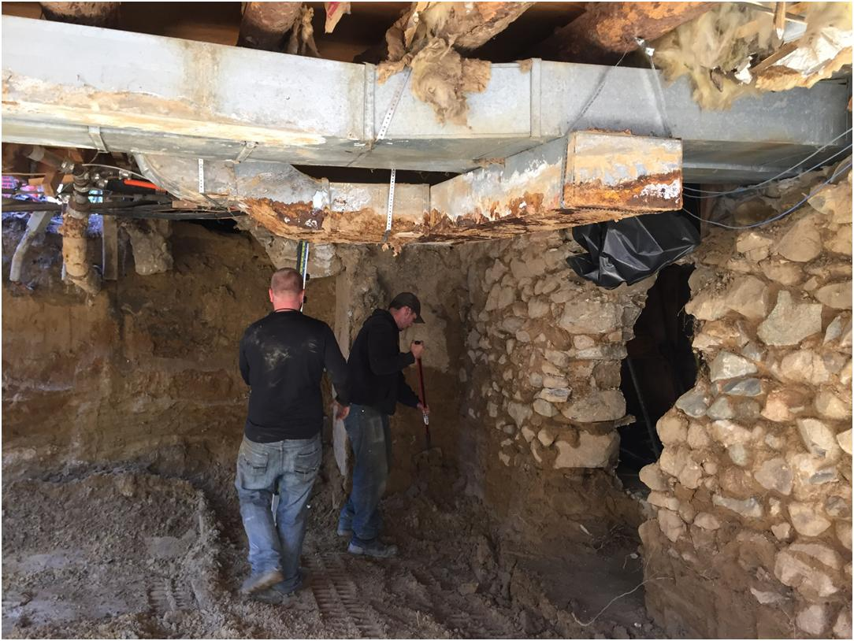

Slide 8
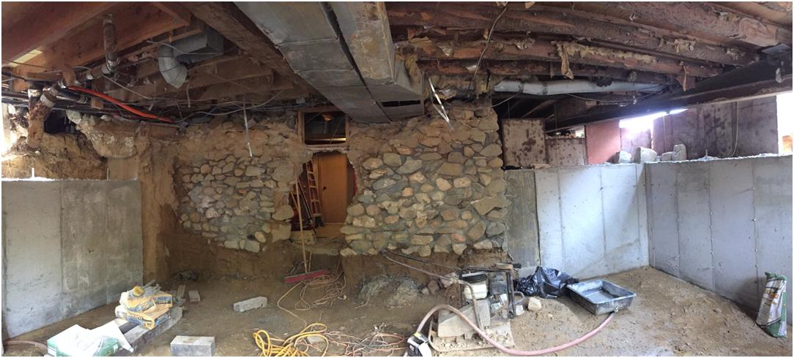

Slide 9
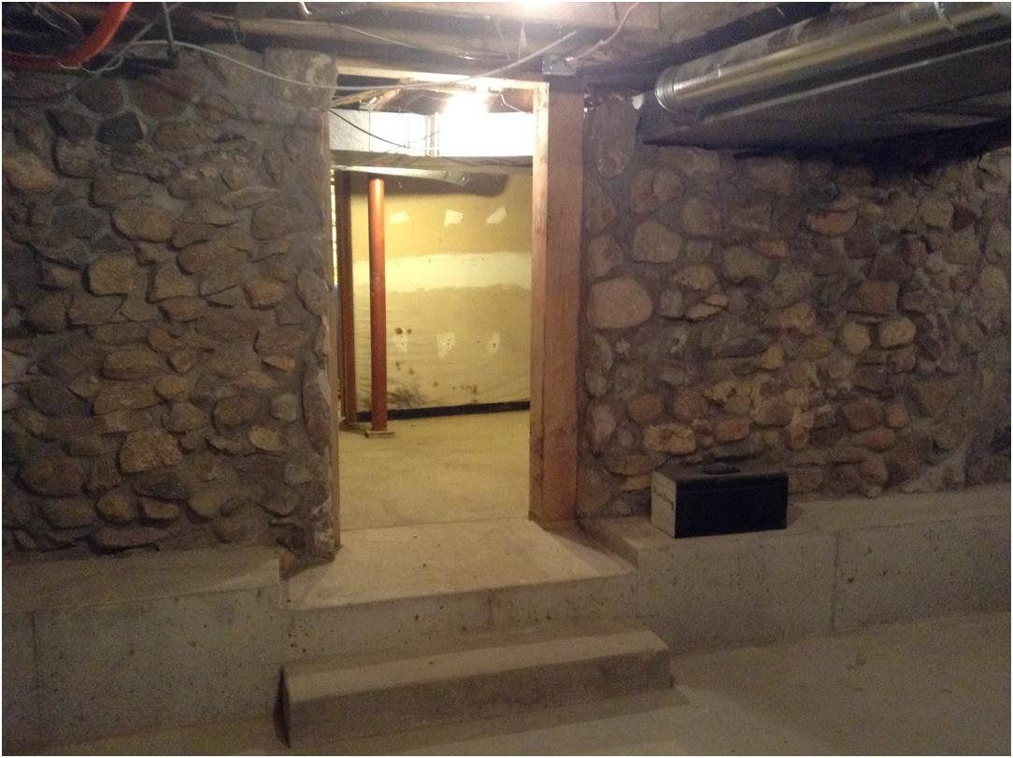

Slide 10
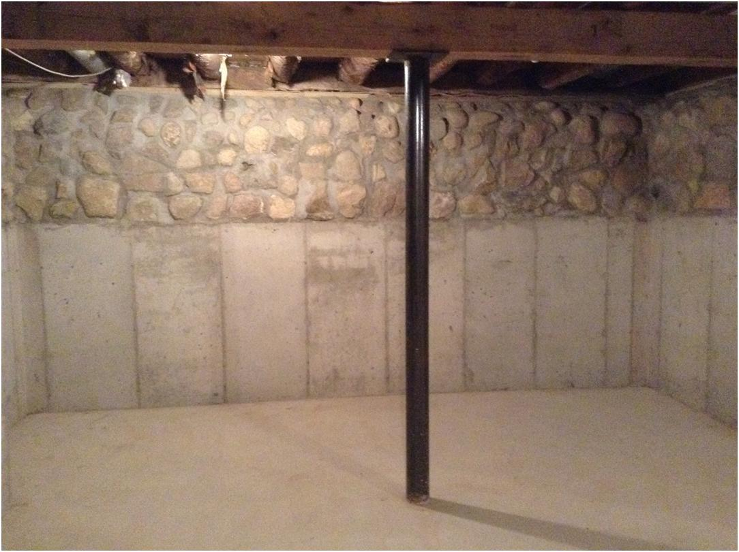

Slide 11
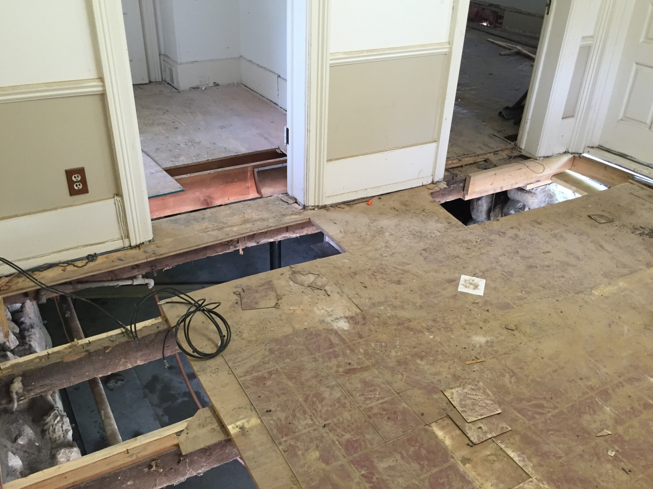

Slide 12
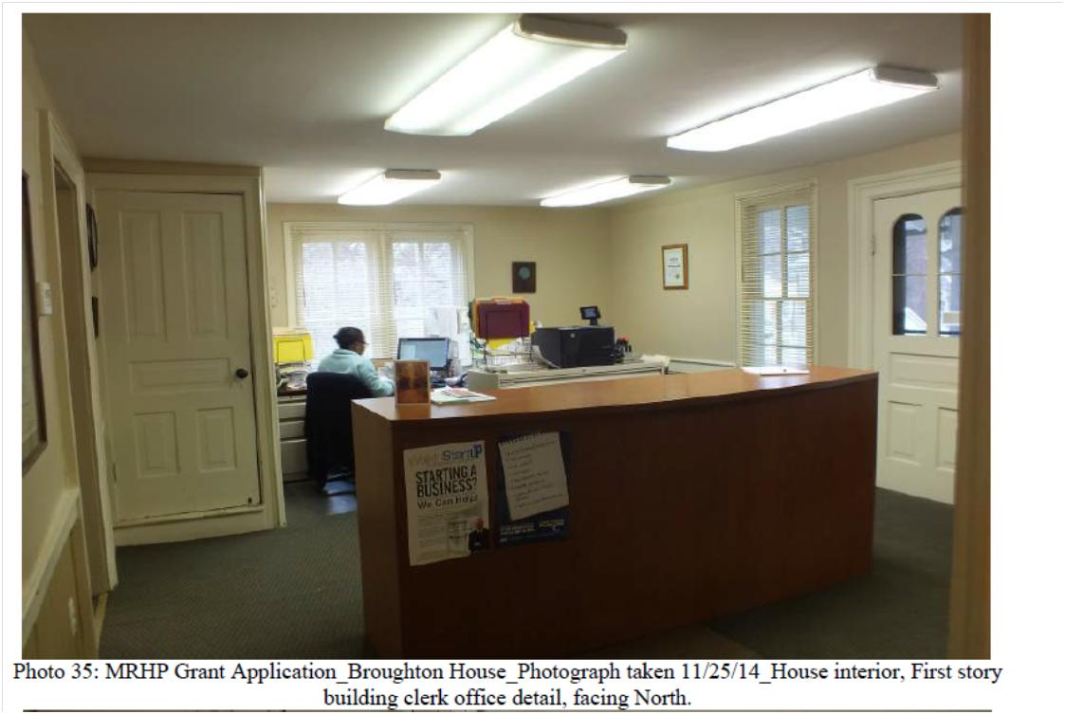

Slide 13
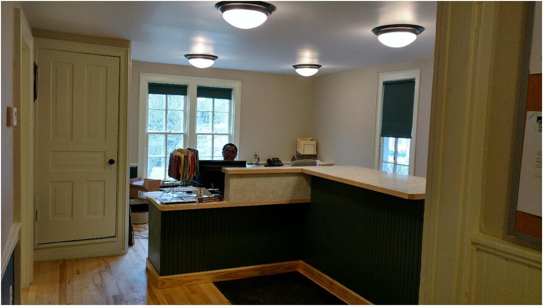

Slide 14
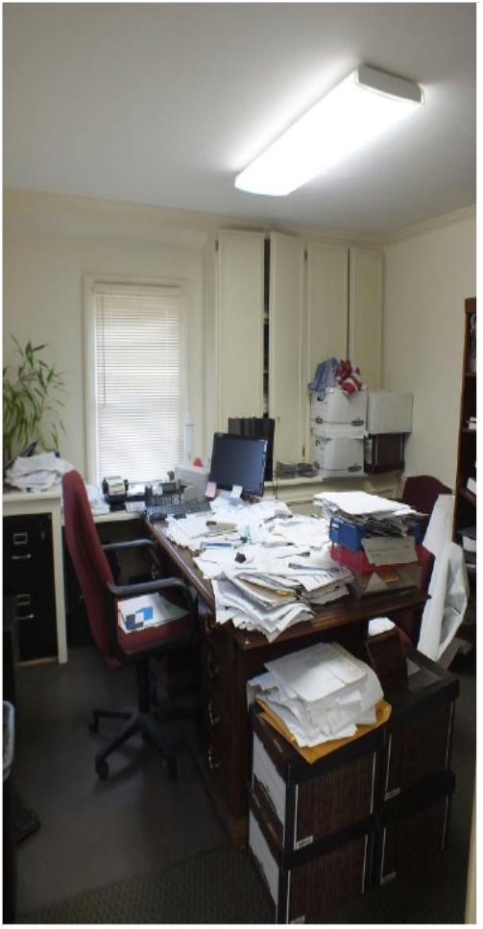
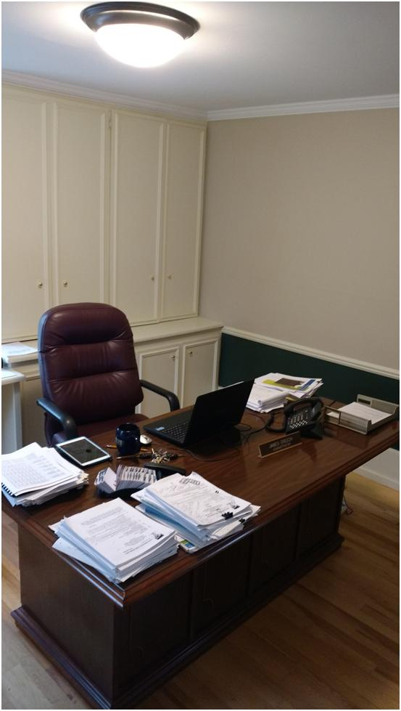

Slide 15
Voter Approved $15 Million Bond
Community Review of Plans late March
Bidding early April
Bonding in May
First phase of Street Improvements to begin May/June 2017.
Brings all roads with the Village’s jurisdiction to good to very good rating. Currently, 95% of Village roads rated at fair to poor.

Slide 16
ROAD RATINGS

Slide 17
Master Plan Completion 2015
Implementation
Downtown
Parking
Business retention/attraction
Signage
Pedestrian Accessibility
Lighting

Slide 18
The Village of Franklin
“The Town that Time Forgot”

